Slide 1

Introduction to MS Teams
Lecture : 1
Basic Microsoft Office Programs

Slide 2

What is Microsoft Teams?
Think of Microsoft Teams as a collaboration hub that helps your team stay organized and have conversations, meetings, and share files - all in one place.

Slide 3
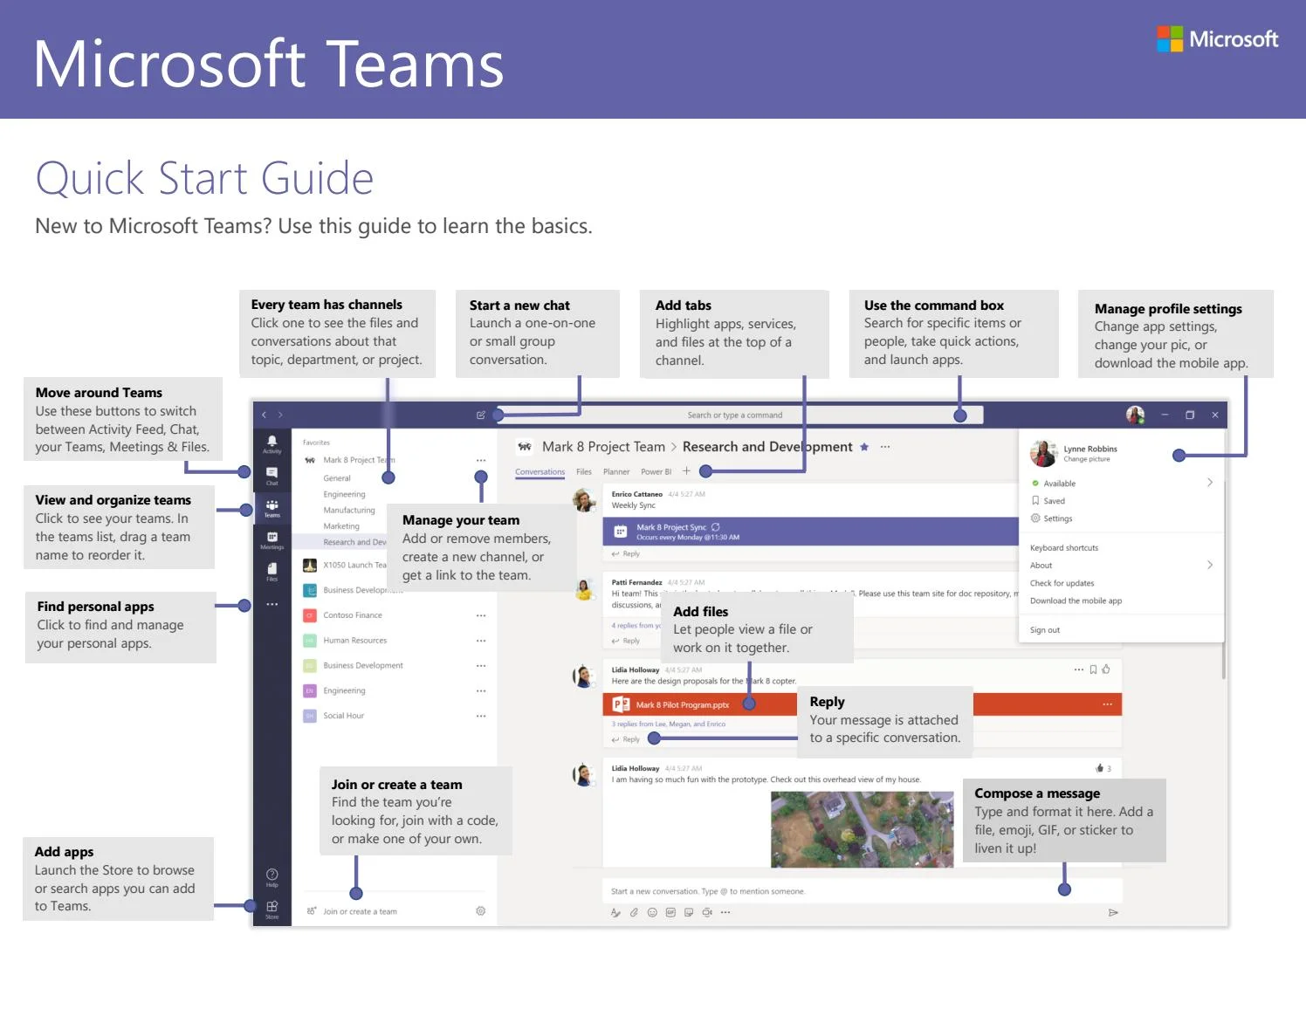
What is Microsoft Teams?

Slide 4
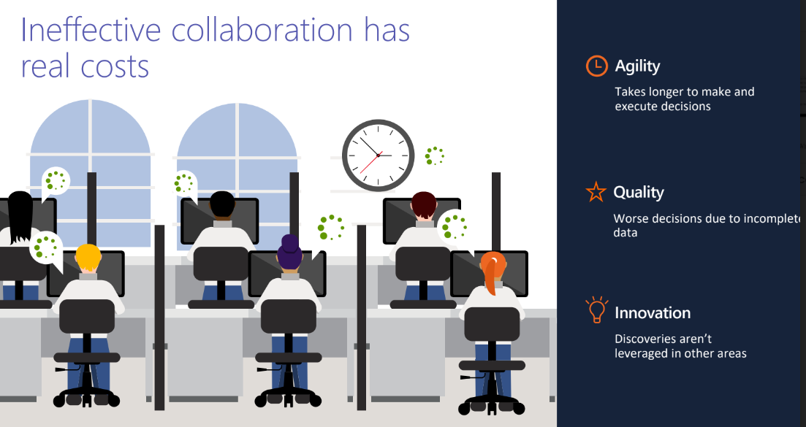

Slide 5
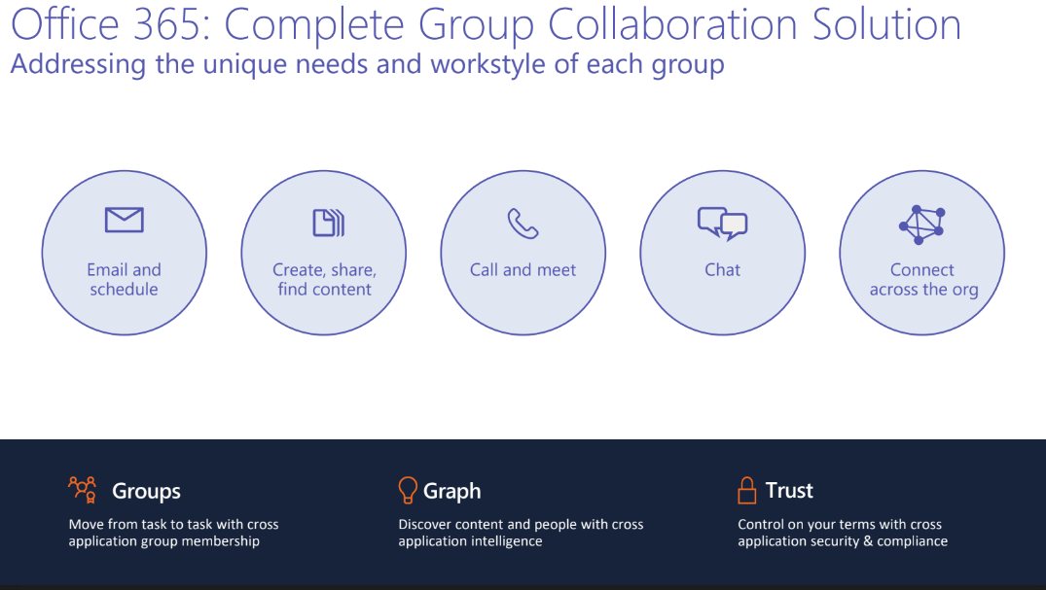

Slide 6
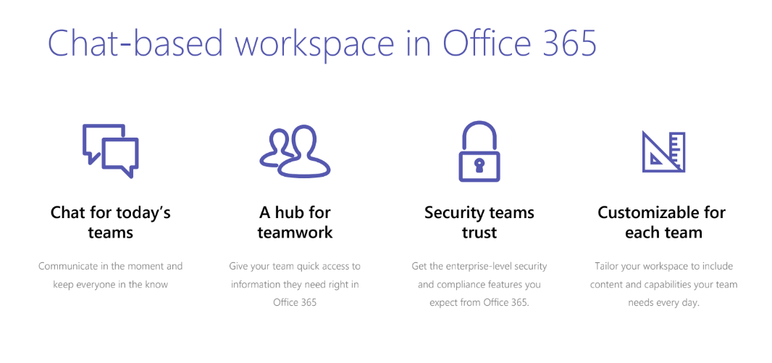
Chat for today’s
teams
Communicate in the moment and
keep everyone in the know
A hub for
teamwork
Give your team quick access to information they need right in
Office 365
Security teams
trust
Get the enterprise-level security and
compliance features you
expect from Office 365.
Customizable for
each team
Tailor your workspace to include content and capabilities your team
needs every day.

Slide 7
3 ways to access MS Teams
1. Web page -
https://teams.microsoft.com
2. Download Microsoft Teams onto your desktop
https://products.office.com/en-gb/microsoft-teams/downloadapp#desktopAppDownloadregion
3. Download Microsoft Teams app on your phone

Slide 8
Creating a Microsoft Account
To create an account-
Access the Microsoft sign-up page. Open any your web browser on your computer, and type “signup.live.com” on the address bar. You will be redirected to the Microsoft sign-up page.
Click on “Sign up now.” This will be on the right of the sign-up page. You will be redirected to the form where you fill in the details for the account.

Slide 9
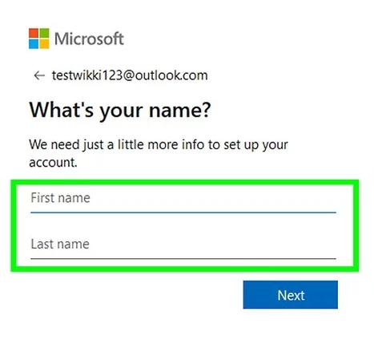
Creating a Microsoft Account
To create an account-
Enter your full name and then select a username. First, it will ask for your first and last name, and then for a username. If you have a Gmail or Yahoo account, you can use that as a username for the Microsoft sign-in.

Slide 10
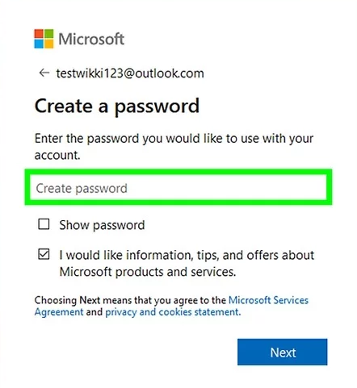
Creating a Microsoft Account
To create an account-
Create a password next. Make sure your Microsoft account password is at least 8 characters long and contains at least two of the following: uppercase letters, lowercase letters, numbers, and symbols. Reenter the password for confirmation when you’re done.

Slide 11
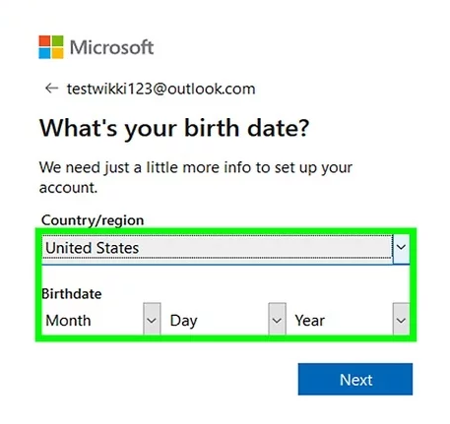
Creating a Microsoft Account
To create an account-
Enter your country, birthdate, and gender last. The fields for these three pieces of information are drop-down options. Just click the down arrow to the right of the text boxes and select the country, date, and gender.

Slide 12
Creating a Microsoft Account
To create an account-
Verify the information given. Select your country code from the drop-down option below Gender and enter your phone number in the box below that. You will receive a text verification code or an audio call to verify that you’re a real person and not a bot.

Slide 13
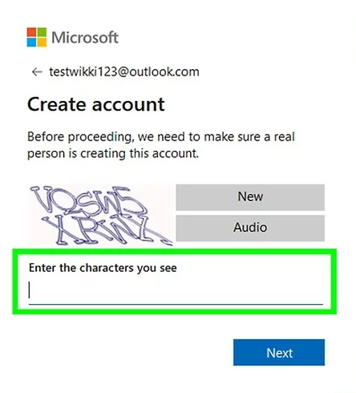
Creating a Microsoft Account
To create an account-
Check out the characters you see in the box below the phone number. This is a Captcha. Enter it in the “Enter the characters you see” field. This is also to ensure that you are a real person.

Slide 14
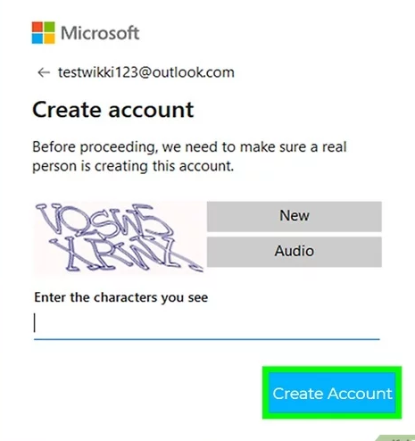
Creating a Microsoft Account
To create an account-
Click “Create Account” at the bottom. You have just set up your Microsoft account, but before you can use Microsoft services, you must verify the email address (username) you entered. Open the email sent to the email address you registered as username and click the link given to confirm. Your account has been created and verified. You can now use Microsoft services with the account.

Slide 15
Accessing MS Teams through Web Page
1. Click on the link -
https://teams.microsoft.com
2. Enter username and password of your microsoft account
3. Click on the “Sign in” button.

Slide 16
Download Microsoft Teams onto your desktop
1. Click on the link -
https://www.microsoft.com/en-us/microsoft-teams/download-app#desktopAppDownloadregion
2. Click Download app for desktop.
3. Click Download the new Teams app under Teams for work or school. When the dropdown appears, select Download for Windows (64-bit).

Slide 17
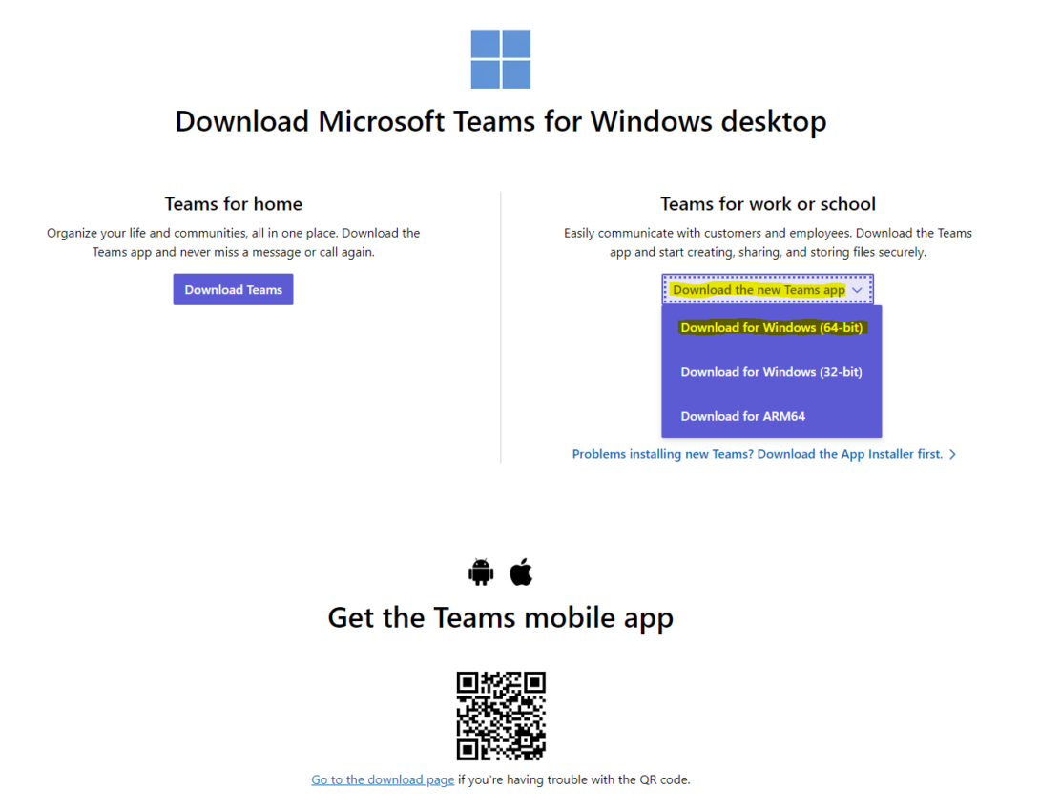
Download Microsoft Teams onto your desktop

Slide 18
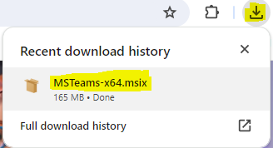
Download Microsoft Teams onto your desktop
4. Click the executable file MSTeams-x64.msix.

Slide 19
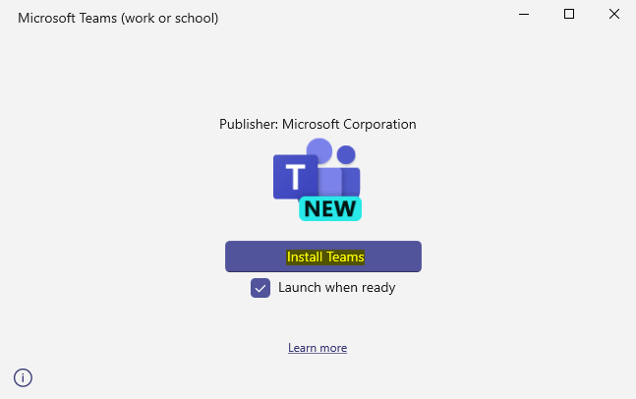
Download Microsoft Teams onto your desktop
5. This prompt will then appear. Click Install Teams. Make sure Launch when ready is checked. Microsoft Teams will then be installed on your computer.

Slide 20
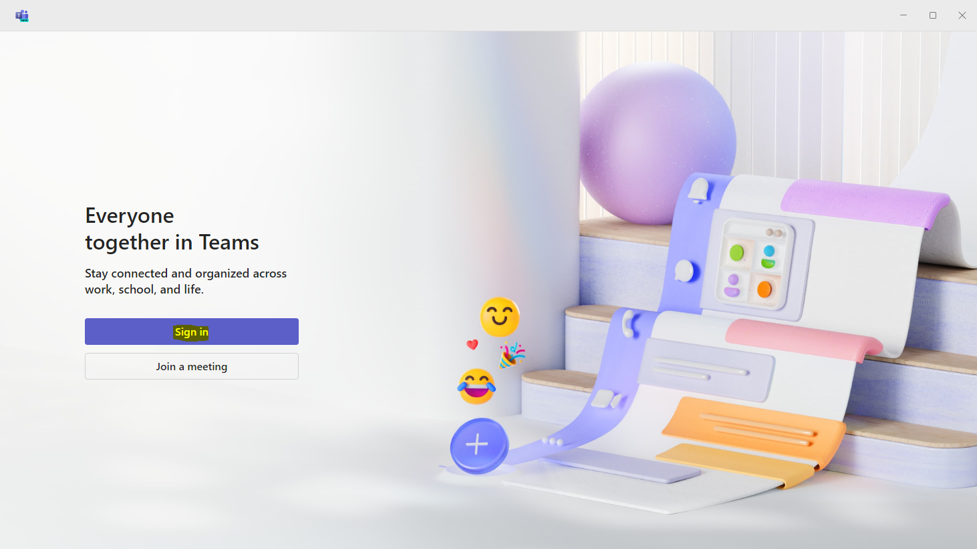
Download Microsoft Teams onto your desktop
6. Select Sign in, then sign in with your WCSU email credentials.

Slide 21
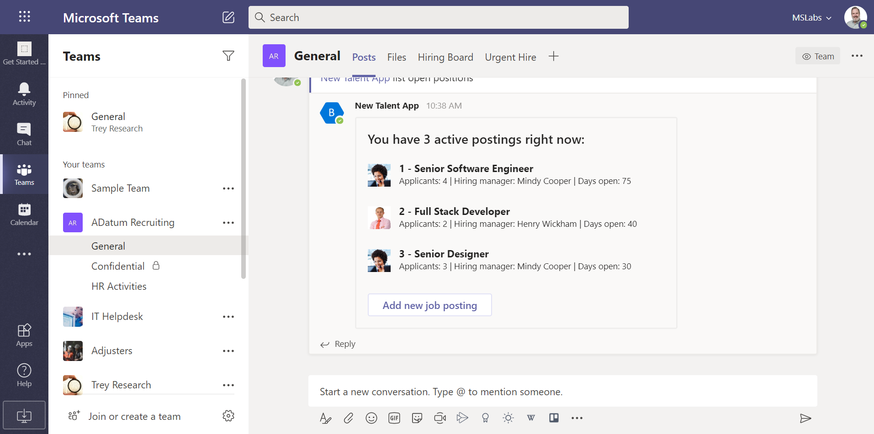
MS Team Features
Teams
Teams are the overall group of people working on a project.
They can range in size from a small product team to a larger organization.

Slide 22
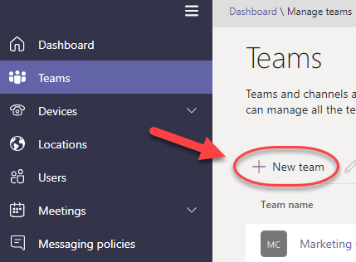
MS Team Features
Create Teams
Create teams by adding member individually by email aliases or security groups. Every new team will have a default favorite channel called General, you can use it for whatever you like.

Slide 23
MS Team Features
Teams Owners
There can only be 10 owners per Team
Owners can:
• Add new members and other owners
• Manage Team settings
• Enable\Disable @Mentioning
• Allowing GIFs, stickers, memes, and
moderation settings
• Rename the Team
• Delete the Team
Teams Members
• There can be as many as 600 members per Team
• Members can add additional channels to the team

Slide 24
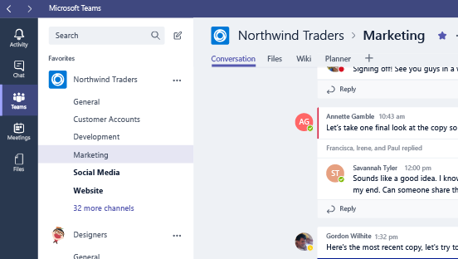
MS Team Features
Channel
Teams are made up of Channels, each covering a different topic. Only favorite Channels will show up in the left pane, other channels will show up if there is a notification for you. The remaining channels can be accessed by clicking more.

Slide 25
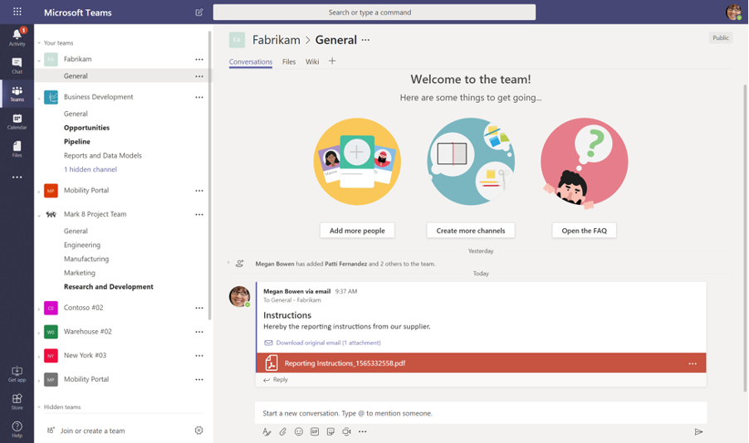
MS Team Features
Creating Channels
Channels are open to everyone on the Team, so anyone can drop in and see what everyone is talking about. Channels can be created to cover Topics, Departments, or Projects.

Slide 26
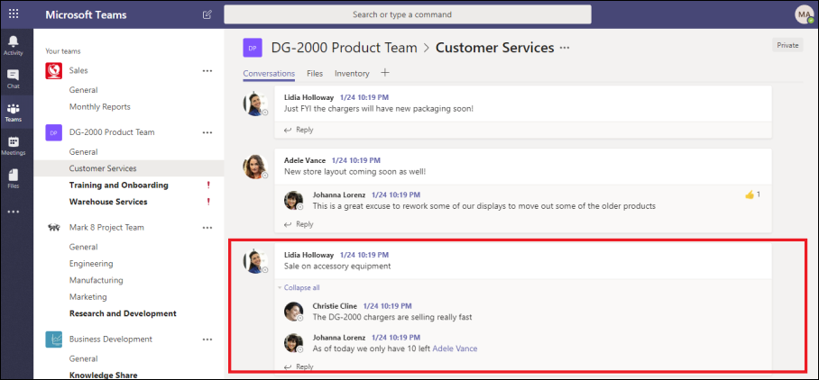
MS Team Features
Threaded Conversations
In channels you can reply directly to a message, keeping the discussion easy to follow.

Slide 27
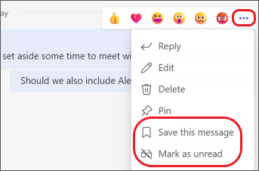
MS Team Features
Like and Save messages
At the top right corner of all messages in Channels, you have an option to like messages or save them for later. Saved messages will be kept in Saved along the left rail.

Slide 28
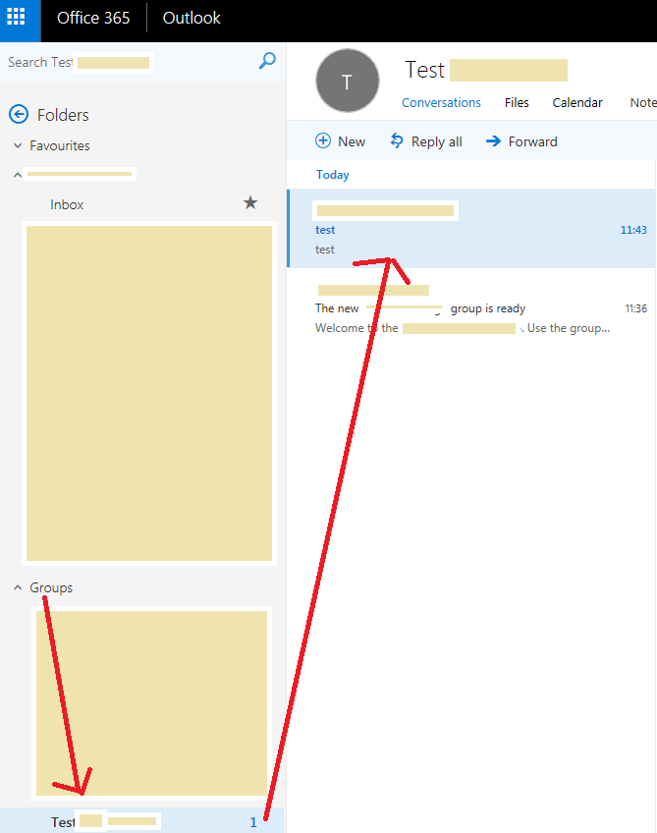
MS Team Features
Documents and Conversations
You can review a file with the conversation along side it. When you give feedback and comment, it’ll also appear back in the channel so no one loses the history.

Slide 29
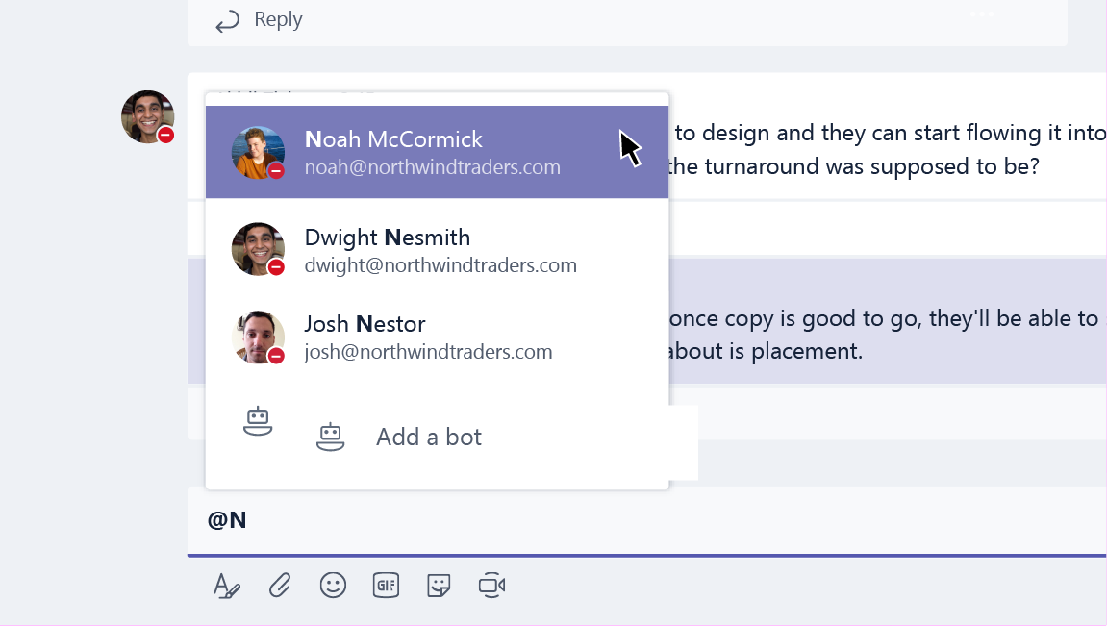
MS Team Features
Mention Team Members
You can also bring people’s attention by @Mentioning them, just type the @ symbol before their name. And if you admin enables it, you can @mention your whole team or any channel.

Slide 30
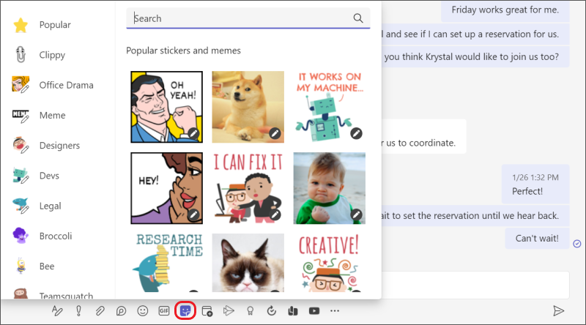
MS Team Features
Ways to Express Yourself
Everything from emojis to GIFs to stickers and memes that you can actually edit, are there for you to showcase the personality of your team and add some flare to the conversation.

Slide 31
Protocols while using MS Teams
Ensure your camera is turned off, it is not permitted for students to have cameras on.
Ensure your microphone is muted, only unmute if asked to do so by the teacher.
Only you can take part in the tutorial. Parents and family members must not ask questions.
If you need to ask/respond to a question, use the “Raise Hand” function to get the teachers attention.
You can ask a question in writing using the chat function for the teacher to respond to verbally.
Tutorials cannot be recorded, the record option on TEAMS has been disabled.
The teacher may decide to have their camera on with a blurred background to support explanation.

Slide 32
Platform Requirements
Clients:
• Windows 7+ (7, 8, 8.1, 10)
• Mac OSX 10.10+
• Windows Phone 10.0.10586+
• Android 4.4+
• iOS (iPhone and iPad) 9+
Web:
• Chrome: 51.0+
• Firefox: 47.0+
• Edge: 12+
• MSIE: 11+
• Safari coming soon.

Slide 33
O365 Licensing Requirements
Microsoft Teams is currently available in preview to customers with
Business Essentials
Business Premium
Enterprise E1, E3, and E5 subscriptions.
Existing E4 subscriptions (Retired SKU)

Slide 34
Deployment Requirements
Organizations are recommended to have:
User Mailboxes homed on Exchange Online
SharePoint homed online

Slide 35

Let’s do some exercises!

Slide 36

Exercises
Explain how to access MS Teams?
Explain the difference between teams and channel.
What facilities does a team owner have?
Explain MS Team features
5. Suppose your windows does not have a windows 7+ version.
Will you be able to use MS teams ?

Slide 37

Thanks!

